Slide 1
BEES!
Lundquist -- 2017

Slide 2
Humans need bees
1/3 of all meals is made possible by bees
“If the bee disappeared off the face of the Earth, man would only have four years left to live.” – Einstein
Massive famine if they die out

Slide 3
Make dat honey!
Bees pollenate $265 BILLON worth of plants
These plants not only feed us but also our live stock

Slide 4
The beginning of the end
Loss of 30%-90% of bee colonies have died off
5M in 1988
2.5M in 2015

Slide 5
Colony Collapse Disorder
World wide death of bee colonies
Colonies found with VERY few workers and thus the queen dies
No one is quite sure why??

Slide 6
Suspects
Acarapis Woodi
Mites that infect the breathing tubes of bees
Lay eggs & live off the fluids of bees
Weaken the bees

Slide 7
Suspects
Varroa Destructor
Lays eggs on the bee larva
Feed on the young bee
When the young hatches it spreads the mites
Double every 10 days – spreads to the whole colony in a few months

Slide 8
Suspects
Varroa Destructor
Some stay with the bees into adulthood and continue to drain them of bodily fluids
Carry viruses like fleas

Slide 9
Suspects
Varroa Destructor
Acarapis Woodi
Don’t normally kill their host
Bees usually have an immune system that can fight them off
The numbers don’t add up

Slide 10
Suspects
Neonicotinoids
Chemicals similar to nicotine
Approved in 1990
Attack the nervous system
Most used in the world ($1.8B in 2008)
In 2013 was used on 95% of corn crops in the US
Most of the apples, cherries, oranges, blue berries, greens, nuts, etc.

Slide 11
Suspects
Neonicotinoids
Bees collect it with pollen and from water
Bees collect pollen from MANY sources and as they travel to each they collect more and more, this adds up to vast quantities

Slide 12
Suspects
Neonicotinoids
Effects:
Leads to convulsions
Paralysis
Death
Bees communicate by dancing

Slide 13
Suspects
Neonicotinoids
Bees collect it with pollen and from water
Bring it into the hive
Builds up by biomagnification

Slide 14
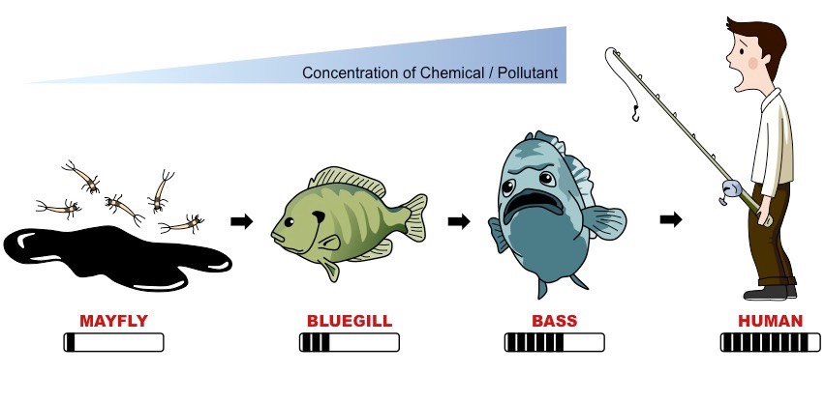
Biomagnification

Slide 15
Suspects
Neonicotinoids
In small doses it can cause bees to become disoriented and fly away from the colony

Slide 16
Suspects
Maybe just us, but could be more
Many factors are to blame
Neonicotinoids weaken the bee population
Parasites become opportunistic
Other factors
Vast monocrops
Little genetic diversity
Over crowding

Slide 17
This weeks assignment
DO SOMETHING!!!
Do some background reading
Read the current EPA plan on CCD and decide if you are satisfied with their response
Read at least 1 more article (news or other) from 2016 - present
Google news
World wildlife
Sierra club
Copy the links into an email
Contact your congressman (find your representative) asking for regulations or in support of the current plan
Send me an email with the link to your alternative article and a copy of what you sent & the link to your external article (you don’t need to send the article to your rep)

