Slide 1
Working out leads to sweating which leads to…
Lundquist – 2015

Slide 2

Why we work out
Weight control
Fights disease
Improves mood
Boosts energy
Sleep better
Increased libido

Slide 3
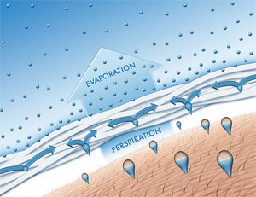
When you work out…
You sweat
  To maintain homeostasis (normal)
    98.7ºF or 37ºC
  H₂O in sweat absorbs heat
Takes in heat and evaporates, cooling you down

Slide 4
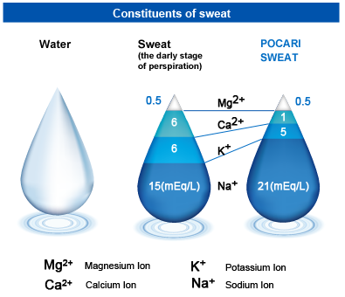
Not just water
Sweat (ok mainly water)
  0.09% Na⁺
  0.02% K⁺
  0.0015% Ca²⁺
  0.00013 Mg²⁺
Electrolytes
  Atoms that can complete a circuit (metal ions)
  Raise the boiling point of the water

Slide 5
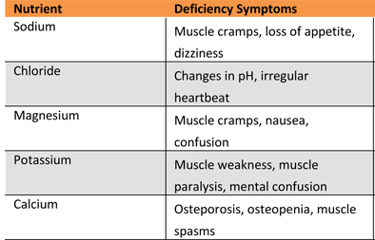
Electrolytes
Used to carry impulses throughout the body
Loose too many and you’ll have problems
Must be replaced
  Salty foods, sports drinks, etc

Slide 6
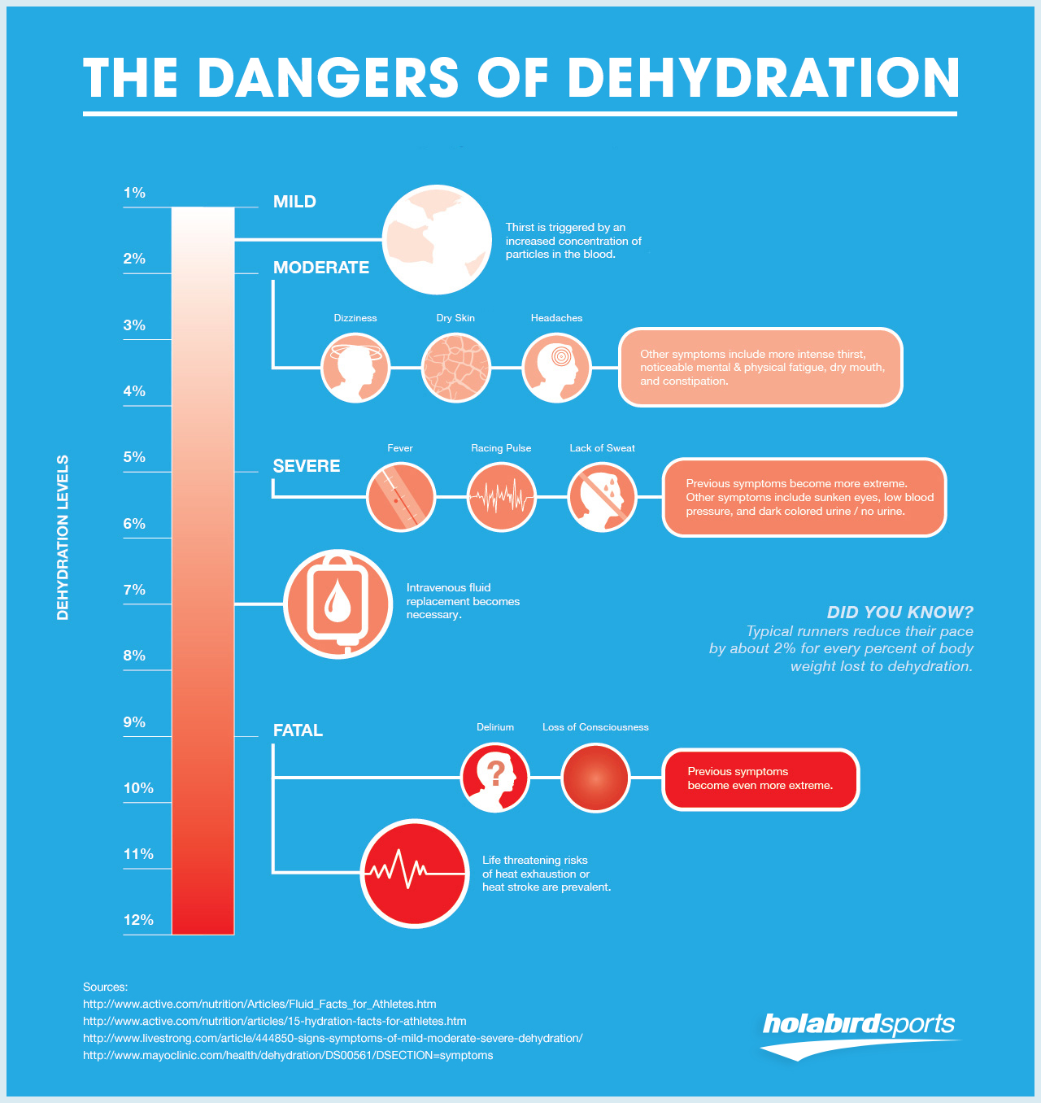
Dehydration
Loosing too much water
  Water & electrolytes

Slide 7
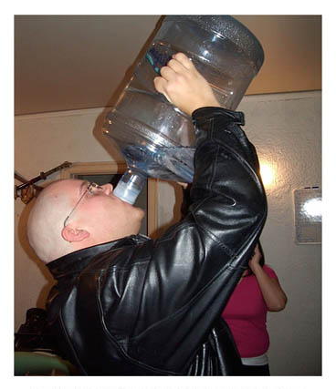
Water intoxication
Water poisoning
Drinking TOO MUCH water
  Thins electrolyte concentration
  Same effects as dehydration & alcohol poisoning

Slide 8
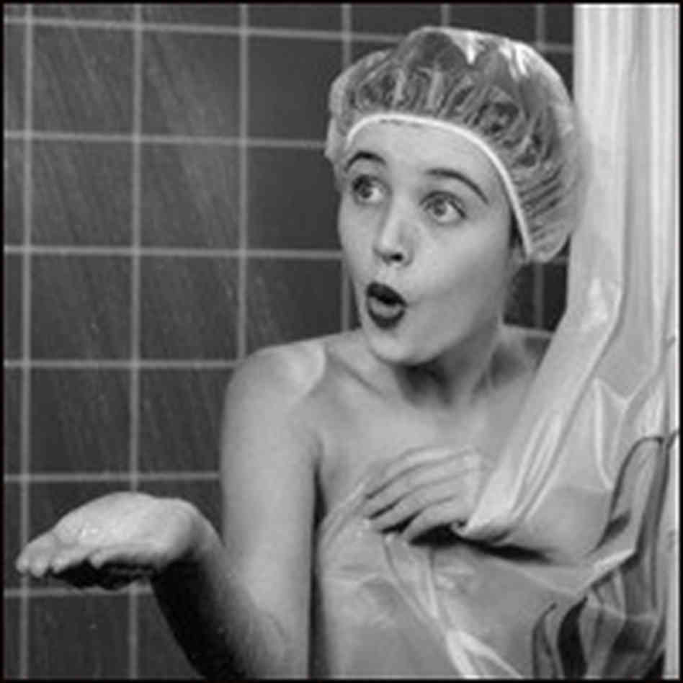
After all that working out…

Slide 9
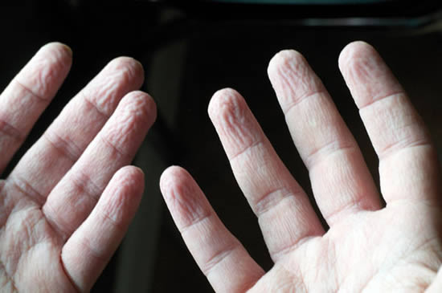
Stay in too long though…

Slide 10
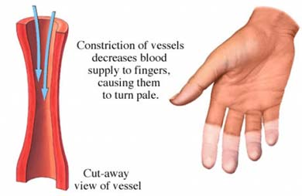
Lots of ideas on why
Heat causes it
  your blood vessels constrict to keep you cool
  Tense up and alter the shape
BUT it happens in cold water too

Slide 11
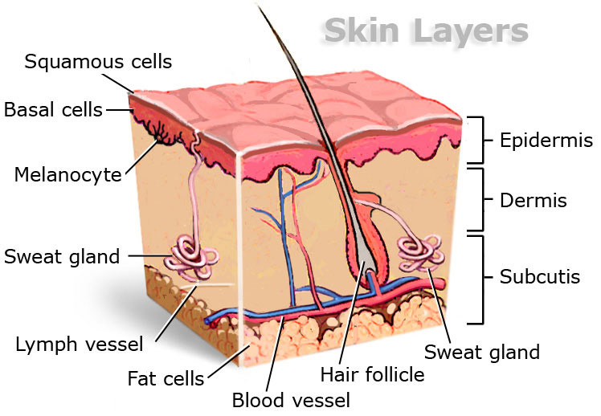
Lots of ideas on why
Water absorbed by your skin
Skin has 2 layers
  Dead
  Alive
  Dead skin could absorb the water

Slide 12
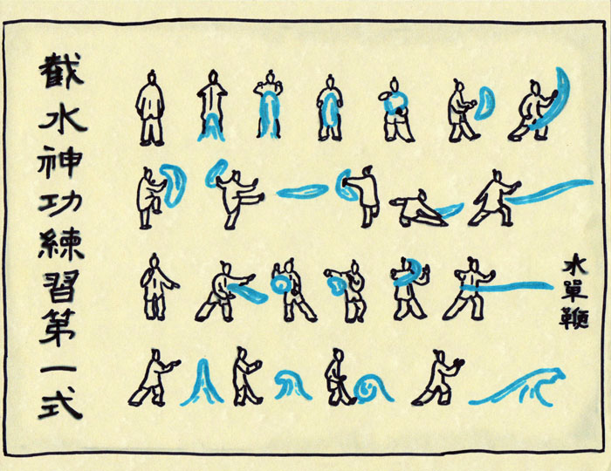
Water moves
  DIFFUSION
  things move from areas where there is a lot of it, to where there is little
  Requires NO energy (passive transport)
Water outside > water inside

Slide 13
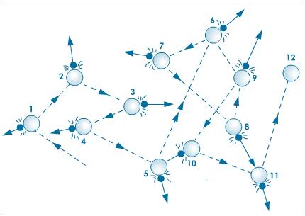
How does diffusion work?
On an atomic scale
  Things are always moving & bumping into each other
  Called Brownian Motion
  Can be increased/decreased with temperature

Slide 14
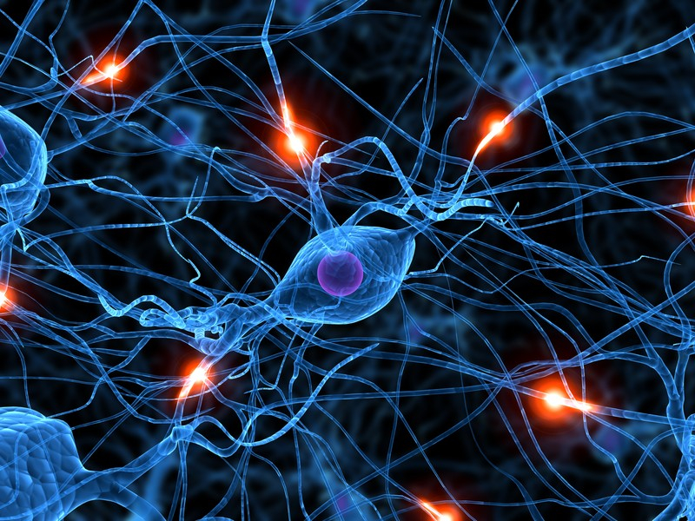
Small problem…
People with nerve damage do not get pruney fingers
Water doesn’t care so it can’t be diffusion
So there must be a neurological part

Slide 15
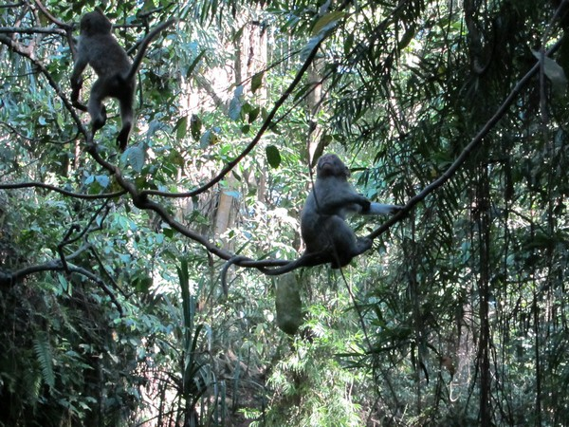
Current theory
Like tire treads
  Pruney fingers increase tractions
  Allowed ancestors better grips in water
  Still debated

