Slide 1
The effect of gender on hand span
Adam Lundquist
BioL 109 Wednesdays 1800

Slide 2
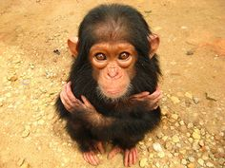
Introduction
Humans are not the only animals with opposable thumbs, also in chimps and monkeys (eatonhand.com)
Male hands are closer in dimensions to apes than female bodies (handresearch.com)

Slide 3
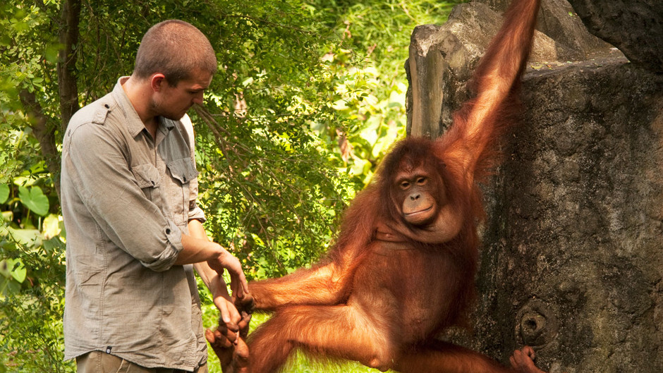
Hypothesis
If male hands are closer in proportions to apes, they will be larger in diameter than female hands

Slide 4
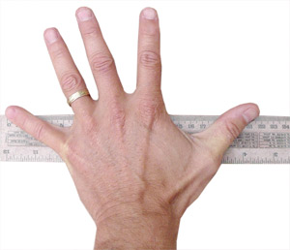
Methods
Collected 25 male and female hands traces
Measured hand span, pinky to thumb, in centimeters

Slide 5
Data

Slide 6
Data

Slide 7
Conclusion
Female
Average =19cm
Male
Average = 21cm
HOWEVER:
Not statistically different from one another
Male – variance = 19cm
Female + variance = 21cm
We reject our hypothesis

Slide 8
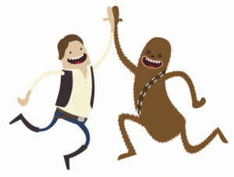
Why?
Hand span falls under a continuum
Not coded for my a single gene
Therefore not two/three alleles for hand sized.
If there were hand span would be set values
Instead we see a wide range of hand spans
Known as a complex trait

Slide 9
Why, why?
Complex traits don’t follow Mendillian genetics (Molleck)
Mendillian genetics follow strict patterns of dominant to recessive (Falconer et al.)
Allows greater variation

Slide 10
Works cited
Molleck, 2000. Introduction to biological science. Prinston-hall. Austin, TX
Falconer, D. S. & Mackay TFC (1996). Introduction to Quantitative Genetics. Fourth edition. Addison Wesley Longman, Harlow, Essex, UK.
Eatonhand.com, Google. 1st Jan, 2015
Hand Research.com, NHIM.org. 1st Jan, 2015

