Slide 1
The power of power poses
And other bad science
Lundquist -- 2020

Slide 2
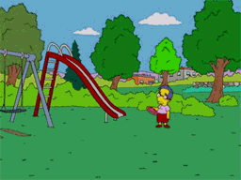
What a time to be alive
Social media has connected us like never before
  Incidences are instantly shared and distributed around the globe
  You join groups of like minded people, who share similar ideas with you
However it has also never isolated us so much
  These tend to insulate us from new ideas and blind us to new information

Slide 3
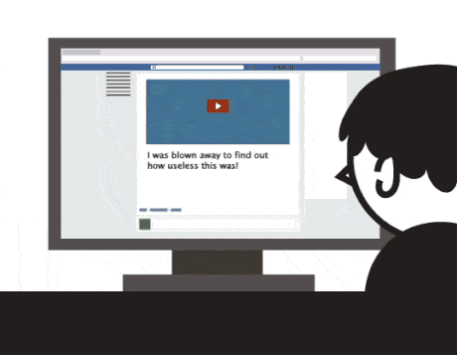
Click bait
Journalist have to fight against this insulation and draw your attention
Snappy headlines give people something to share and talk about
More shares mean more interest in a piece, so they get more attention

Slide 4
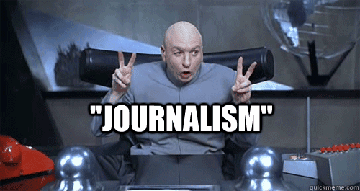
Know what you’re looking at
You should always read more than the title
  Case studies make great head lines but can have SEVERAL flaws!
  The case of Bohannon and “Chocolate causes weight loss”

Slide 5
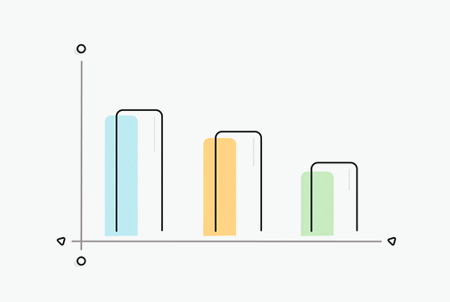
Statistical Tests
Researches use statistics to give us a quantifiable way to view results
When they say they found that two things are linked its because in a study one group took a drug, and one did not (the control group).
The non-control group changed by a statistically significant amount
  But what is statistically significant?
  Did the control group take a placebo?

Slide 6
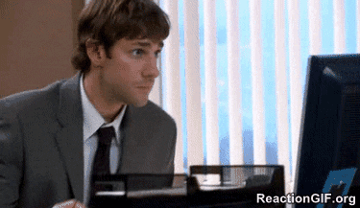
What makes a good study
Good statistical tests
Large population sizes
Random samples
Controls
Replicated
Articles don’t always list these things, you may want to look at the article directly
(not always fun)

Slide 7
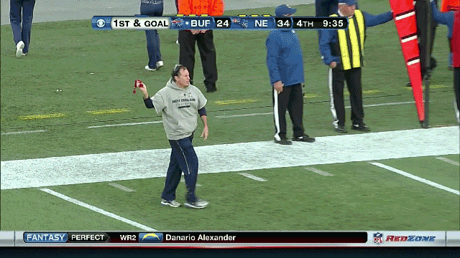
Red flags
Who wrote it
Who published it
Who did the science
Who funded the science

Slide 8
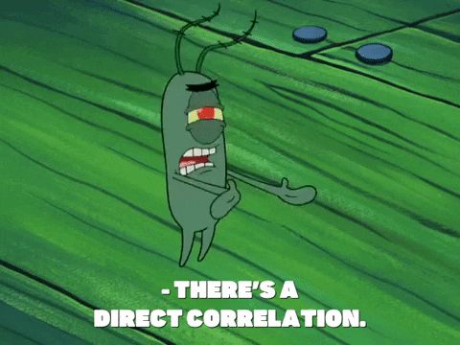
Do the claims match up
Flashy titles don’t mean as much as you think
The main article can put the word “significant” in perspective
Beware causation

Slide 9
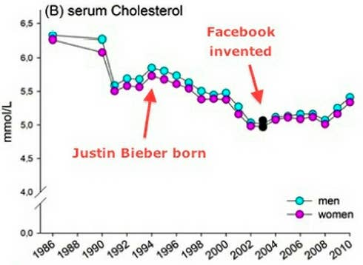
Correlation does not mean causation
There are many variables at play and understanding how they might be related is important
Just because they happen together does not mean that one causes the other
  Only studies with randomized designs and control groups should support causation

Slide 10
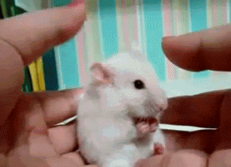
Mice and Men
Due to a long (and slightly complicated) history, lots of studies are done in mice or rats
You are not a mouse/rat and so these results can be VERY different in people
Also “in vitro” does not mean “in people”

Slide 11
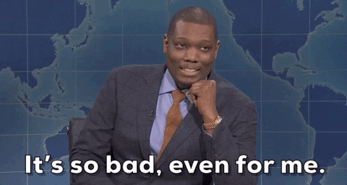
There's a big problem with science today
We have a reproducibility crisis
Large percentages of studies are not reproducible

Slide 12
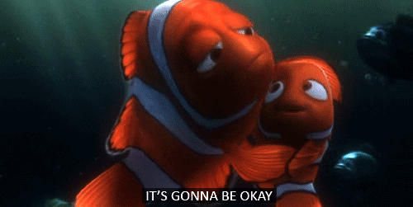
Its not all bad
You should still read science articles, and listen to new ideas
Was it done in mice or monkeys
Did they have random samples, controls, etc.
However be critical of flashy titles
Go to the source for big changes or idea before sharing
The bigger the life change, the more you should research

Slide 13
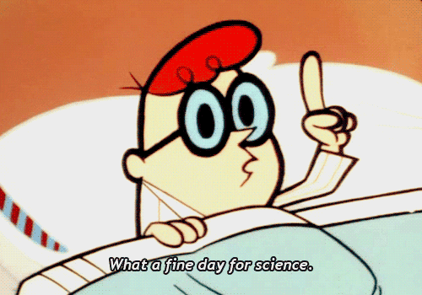
Science is still good
The whole purpose of science is to make mistakes
We use those mistakes to find out how to improve our lives and understanding of the world around us
Organizations around the world are working to improve the strength of experiments, but the best way to improve is to stay informed
Know before you share.

